Slide 1
Analytic Trigonometry
Barnett Ziegler Bylean

Slide 2
Rounding convention
This textbook uses a rounding convention that relies on an understanding of significant digits – significant digits are an indicator of accuracy
Their rule is that you round your answer to the same number of significant digits as the least accurate measures given in the problem.
ie – if all given numbers are whole numbers then round
your answer to the nearest whole number
if the numbers are decimals – round to the same place
value as the given number – (2.1)(3.4)= 7.14≈ 7.1
I will not take off for rounding errors on a test or quiz – in general if the given values have decimals in them your answer should also indicate decimal values.
Avoid rounding whenever possible -

Slide 3
Chapter 1
Right Triangle Ratios

Slide 4
Ch 1 - section 1
Angles, degrees, and arcs

Slide 5
Angles
An angle is formed when the endpoints of 2 rays or segments intersect.
The common endpoint is called a vertex
Standard position: placing an angle on a coordinate grid facilitates discussion of the angle – standard position places the vertex at the origin and one side (the initial side) on the x-axis
The other side (ray or segment) can then be rotated forming varying angles

Slide 6
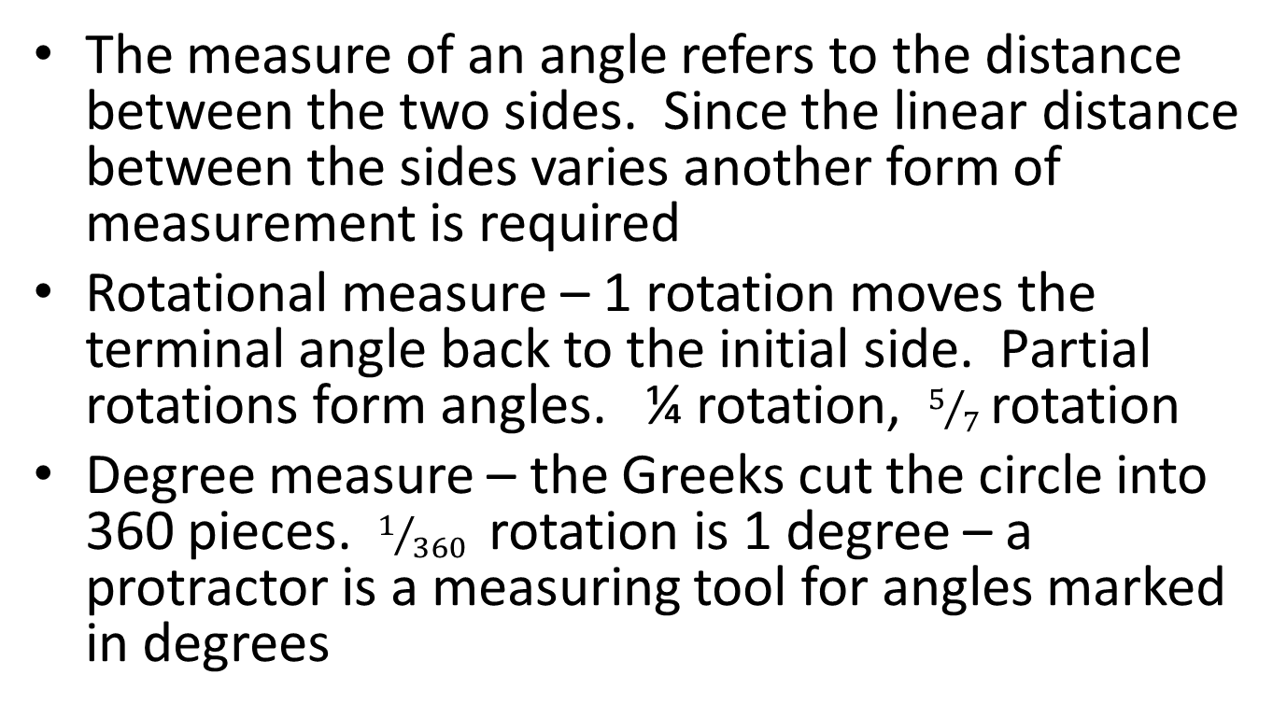
Measuring angles
The measure of an angle refers to the distance between the two sides. Since the linear distance between the sides varies another form of measurement is required
Rotational measure – 1 rotation moves the terminal angle back to the initial side. Partial rotations form angles. ¼ rotation, $5/7$rotation
Degree measure – the Greeks cut the circle into 360 pieces. $1/{360}$ rotation is 1 degree – a protractor is a measuring tool for angles marked in degrees

Slide 7
Examples

Slide 8
Classifying angles
Acute
Right
Obtuse
Reflex

Slide 9
Converting rotations/degrees
1⁰ = 1/360 rev 1 rev = 360⁰
Examples: convert revolutions to degrees
Examples: convert degrees to revolutions

Slide 10
Degrees/minutes/seconds
360 is a useful number since it has so many factors (It can be divided by 1, 2, 3, 4, 5, 6, 8, 9, 10, 12, 15, 18, 20, 30, etc.) and is a reasonably small unit.
When, however, more precision is required the degree is broken into minutes and then the minutes into seconds with the following conversions: 1⁰ = 60 minutes (60’)
1’ = 60 seconds (60”)

Slide 11
DD vs DMS
For precise measures DMS is the most accurate but for convenience with some operations the DD form is used
Example: converting DMS to DD
Example: converting DD to DMS

Slide 12
Arcs/sectors
The curved segment running from the endpoint of the initial segment to the endpoint of the terminal segment of an angle with vertex at the center of a circle is called an arc
The area enclosed by the angle and the arc is called a sector
An arc can be measured two ways
1. by the angle that forms it (subtends) (called a central
angle)- uniform no matter where the circle is drawn)
2. by its length (if straightened out) – changes
according to the length of the angle’s segments -
radius
C=2πr A=πr²

Slide 13
Computing arc length/sector area
C=2πr A=πr²
$\frac{s}{C}=\frac{θ}{360}$ $\frac{A_{s}}{A}=\frac{θ}{360}$
Example: given a radius of 6cm
find the arc length subtended by a 30⁰
central angle
find the area of the sector formed with a 25⁰
angle

Slide 14
Ch1 – section 2
Similar triangles

Slide 15
Triangles
△ABC
The sum of the angles of a triangle is always 180⁰
Triangles are similar if corresponding angles are congruent
if ⦟A ≅ ⦟D
⦟B ≅ ⦟E
⦟C ≅ ⦟F
then △ABC ∼△DEF but △ABC≁△EFD or △FDE
Corresponding sides of similar triangles are in proportion
$\frac{AB}{DE}=\frac{BC}{EF}=\frac{CA}{FD} ≠\frac{AB}{EF}≠\frac{AB}{FD}$ etc.

Slide 16
Showing that 2 triangles are similar
The sum of the angles of a triangle is always 180⁰
Therefore if any 2 angles of one triangle are congruent to 2 angles of a 2nd triangle the triangles are congruent -
If one pair of angles of the pair of triangles is congruent and all CORRESPONDING sides are in ratio then the triangles are similar – this method is not relevant to our study

Slide 17
Solving a triangle
There are 6 measurable parts to a triangle
3 sides and 3 angles
Given the measures of one triangle and at least one side of the second similar triangle you can find any and all parts of the second triangle

Slide 18
Examples
Given △ABC∼△A’B’C’ with sides a,b,c corresponding to a’, b’, c’
if a = 3, b = 8, c = 7, a’ = 6 find b’ and c’
If a = 1.8 b= 0.03 a’ = 2.8 x 10⁻³ find b’
Find the height of a tree with a 12 foot shadow if a person that is 63inches tall casts a shadow that is 4.5 feet long

Slide 19
Ch 1 – section 3
Trigonometric Ratios

Slide 20
Concentrating on right triangles
We will now narrow our focus to right triangles
a²+b²=c²
We define 6 ratios
cosine: $\cos{(θ)=\frac{a}{c}}$ secant: $sec({θ)=\frac{c}{a}}$
sine: $\sin{(θ)=\frac{b}{c}}$ cosecant: $\csc{(θ)=\frac{c}{b}}$
tangent: $\tan{(θ)=\frac{a}{b}}$ cotangent $\cot{(θ=\frac{b}{a}}$
It is of interest to note that cos(ө) = sec(ө)^{-1 (reciprocal)}
sin(ө) =csc(ө)⁻¹
tan(ө) = cot(ө)⁻¹
These statements are called trig identities and will be discussed more later.
They allow us to extrapolate information about tan(ө), sec(ө), csc(ө), and cot(ө) through knowledge of cos(ө) and sin(ө)
c
b
ө
a

Slide 21
Consistency of ratios
Given similar right triangles
The proportion $\frac{a}{a′}=\frac{b}{b′}$ can be written as $\frac{a}{b}=\frac{a′}{b′}$
Thus for all right triangles with a given angle ө the 6 ratios are the same and the ratios are therefore associated with the angle given. There are therefore two sets of ratios associated with each right triangle
c
c’
a
a’
ө
ө
b
b’

Slide 22
Complementary angles
note that ф = 90 – ө
Therefore cos (ө)= sin(ф) = sin(90 – ө)
sin(ө) =cos(ф) = cos(90 – ө)
tan (ө)= cot(ф) = cot(90 – ө)
sec(ө) = csc(ф) = csc(90 – ө)
c
ф
b
ө
a

Slide 23
Finding these ratios
estimating using a sketch
draw a 30⁰ angle with the terminal side (hypotenuse) 10 cm. Use direct measurements to estimate the values of the 6 trigonometric ratios
Estimating using calculator
sin(30⁰) cos(12.9⁰) tan(45⁰)

Slide 24
Solving for the angle
Any operator or function has an inverse –
For now we will simply accept this and name 6 functions that inverse the trig functions
cos(ө)→ cos⁻¹(ө) also called arccos(ө)
sin(ө) → sin ⁻¹ also called arcsin
tan(ө) →
sec(ө) →
csec(ө) →
cot(ө) →

Slide 25
Solving the triangle
Given a right triangle and any other 2 measurable pieces of the triangle you can find the other 3 measurable pieces of the triangle
Due to the relations of complementary angles and the reciprocal relationships there is always more than one way to accomplish this

Slide 26
Examples
Solve the described triangle
A. ө = 48⁰ a = 12 inches
Need to find ф, b, c
Choices - you can find any of the 3 first
B. b = 1.87 c = 3.8
Need to find a, ф, ө

Slide 27
Ch 1 – section 4
Applications

Slide 28
hints
Draw a diagram of the problem
Identify right triangles in the diagram
Locate the part of the diagram that answers the question (the variable- unknown)
Determine the correct trig ratio that applies to that part of the diagram and the parts of the diagram that are known (usually more than one will work)

